Slide 1
Version Control with GIT
Using Git in NetBeans: https://netbeans.org/kb/docs/ide/git.html
This document will be refereed to as UGiN in the following slides
Setting up a Github repository (video): https://netbeans.org/kb/docs/ide/github_nb_screencast.html

Slide 2
What is a version control system
A system capable of recording changes made to source code and related documents that are part of a software project.
Version-control software provides a database (repository) that maintains all revisions made to an application by all the programmers involved in it.
It allows developers to revert to a previous version if necessary as well as to review the changes made from one version to another

Slide 3
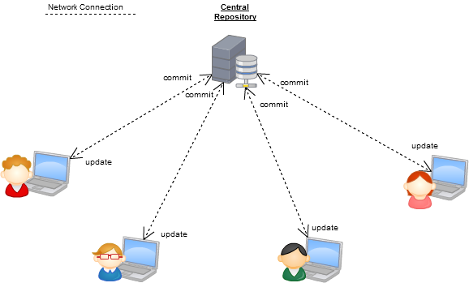
Central Version Control System
Examples: CVS, Subversion
In this model a commit is always to the central repository

Slide 4
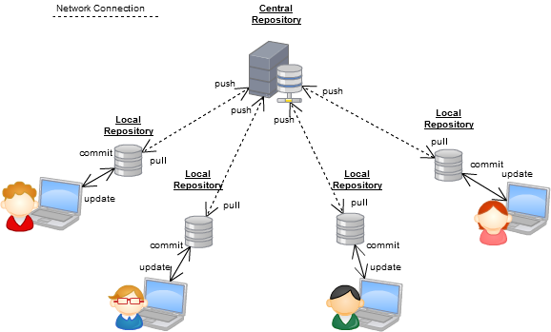
Distributed Version Control System DVCS
Examples: GIT, Mercurial
In this model a commit is a to a local repository. Adding changes to the central repository requires an additional Push.

Slide 5




Distributed Version Control System Working with a DVCS
Working Directiory
Commit
Push
Update
Pull
Central
Repository
Having a local repository for each endpoint give us the ability to work offline without connecting to a central repository.
Since all the historical data is in the local repository we can get older versions and even merge them offline.

Slide 6
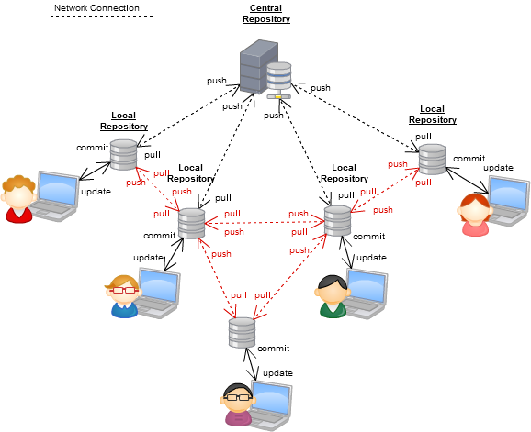
Distributed Version Control System
Because anyone with a repository can also act as server in a distributed model like this, peers can push/pull between themselves.
Ref: http://docs.joomla.org/Dvcs

Slide 7



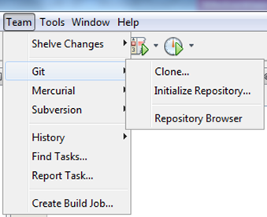
Version Control this semester
Git is a free and open source distributed version control system designed to handle everything from small to very large projects with speed and efficiency.
There are many hosting services available for Git users.
We recommend GitHub which is a web-based hosting service for software development projects that use the Git revision control system.
The NetBeans IDE provides support for the Git version control client out of the box.
The IDE's Git support allows you to perform versioning tasks directly from your project within the IDE

Slide 8
Important Git Terms
Working Directory
This is the directory where the checked out files reside. Its where you do your work. You can add, remove and modify files in the working directory.
INDEX (Staging area)
The git “index” is where you place files you want committed to the git repository.
Before you “commit” files to the git repository, you need to first place the files in the git “index”.
HEAD
The HEAD is a pointer to the most recent commit on the current branch.
The git command to see changes is git status (from a command promt).
A similar command in NetBeans is “Show Changes”
Note: You can abstract away the distinction between Working Directory and Index in NetBeans, and commit files directly to HEAD (See “Add files to a Git Repository” in UGiN)
http://www.gitguys.com/topics/whats-the-deal-with-the-git-index/

Slide 9
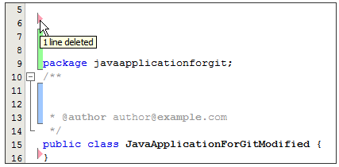

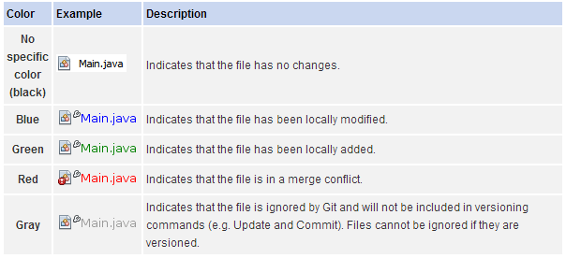
Git Colours in NetBeans
Viewing changes in the Source Editor
Color coding applied to file names

Slide 10
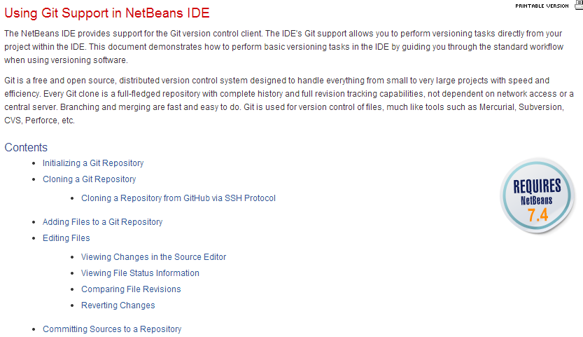
Using Git Support in NetBeans IDE
For all the exercises/demoes given today, this document should be open and consulted repeatedly ;-)
https://netbeans.org/kb/docs/ide/git.html#editing

Slide 11

NetBeans Git Demo

Slide 12

Before you Start
http://www.git-tower.com/learn/version-control-best-practices.html

Slide 13
Commit Rules
Always work with an up-to-date local copy
In order to know about the progress of the overall project and to avoid merge conflicts, before you begin to work, always update your repository by means of a git pull command.
Think before you commit :-)
Commit early commit often
Every committed revision gives you a rollback position. If you screw up, are you rolling back one hour of changes or one week?
The risk of a merge nightmare increases dramatically with time. Merging is never fun. Ever.
Each commit should have a single purpose This makes it easier to locate the changes related to some particular feature or bug fix
Share your changes frequently
Once you have committed changes, you should share those changes with your team as soon as possible by doing Git push (for the same reasons as you should work on a up-to-date copy)
Coordinate with your team
To avoid this tedious, error-prone merge conflicts, you should strive to avoid conflicts by coordinating which parts of the code you touch.

Slide 14
Commit Rules
Test Code before you Commit
Don’t (obviously) Commit code that doesn't compile
Understand which files you should not commit
Take responsibility for the changes you made
If the update you made is creating a problem, take the responsibility of it and make sure to solve it yourself or by getting help
Write descriptive Commit Log Messages
Next Slide

Slide 15

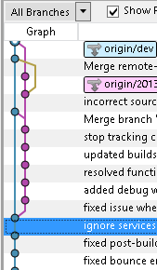
Commit Messages 1
Good collaborators will:
Provide proper Commit messages in order to tell the team what they have done
Provide proper Commit messages for a proper project history
A good commit message should as a minimum have:
An initial line with a short description (never more than 50 characters)
A blank line followed by a body that should answer the following questions
Why was the change necessary
How does it address this issue
What side effect does the script have
(Does it require a script, included with the commit, to be executed against the database)

Slide 16
Commit Messages 2
Always write good commit messages, but don’t be “religious”.
For simple commits (correcting spelling mistakes etc.) you should only add the header line (which must be descriptive :-)

Slide 17

Centralized Workflow-1 Someone initializes the central repository
Create the NetBeans Project
Create a new repository on GitHub
Initialize the project in NetBeans
Perform a Clean Build
Commit the Initial project
Push the Initial project to the central repository
Ref: https://www.atlassian.com/git/workflows#!workflow-centralized

Slide 18
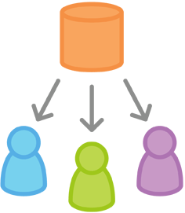
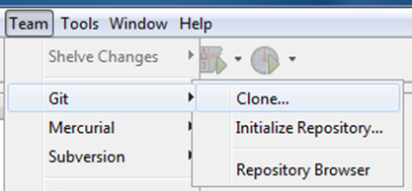
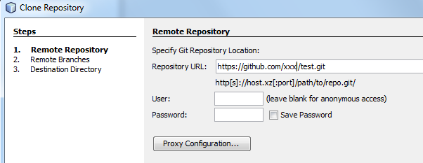
Centralized Workflow.2
Everybody clones the central repository

Slide 19
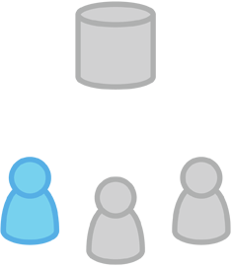
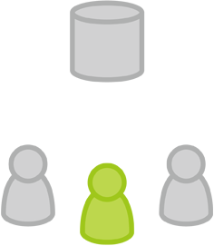
Centralized Workflow 3
John and Mary starts to work on their features
John works on his feature
Mary works on her feature

Slide 20
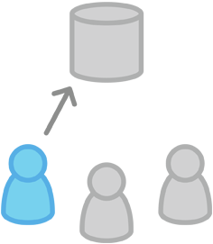
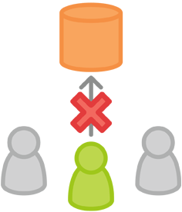
Centralized Workflow 4
John Publishes his feature and Mary tries to
Publish her feature
John publishes his feature
Mary tries to publish her feature

Slide 21
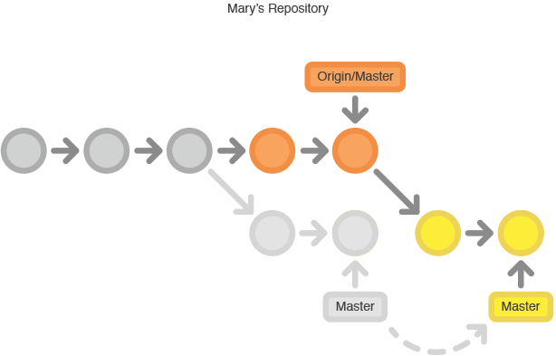
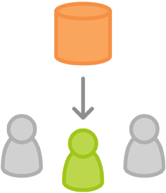
Centralized Workflow 5
Mary rebases on top of John’s commit

Slide 22
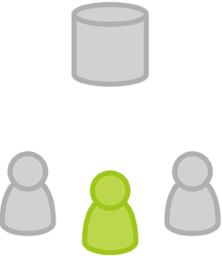
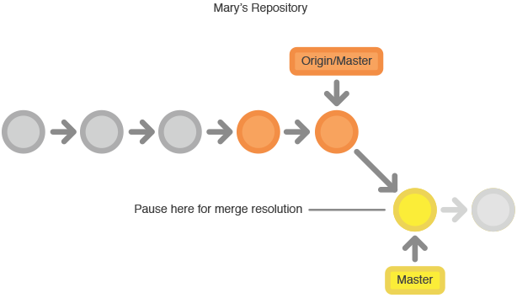
Centralized Workflow 6
Mary resolves a merge conflict

Slide 23
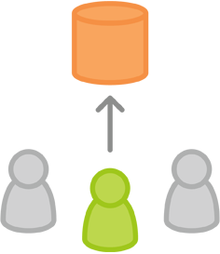
Centralized Workflow 7
Mary successfully publishes her new feature

Slide 24
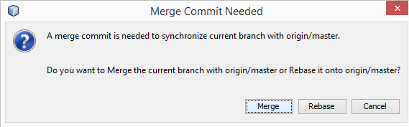
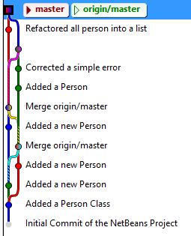
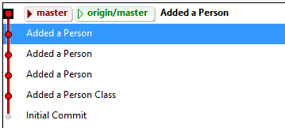
Merge or Rebase
History with Merge Commits
History with Rebase

Slide 25
What if you just want to play around and try a lot of different things on the project ?
Create a new feature Branch (not recommended until you get comfortable with Git)
Create a new Clone somewhere else on your system, which you will never push to the central repository. Are there things from this project you want to include in the real project merge them into the real clone and commit-push from here.

Slide 26
Stupid things I have seen
You are not entirely comfortable with git.
You have something you want to commit/push, but you don’t dare ;-)
So instead A places some code from his project in DropBox.
B copies the code into his project and is happy with the code, so he commit and pushes the change.
But what happens next time A performs a pull? UPPS.
If you go for GIT, then GIT is how you share you're code

